Slide 1

Dynamic Programming

Slide 2
Dynamic Programming
Dynamic Programming is an algorithm design method that can be used when the solution to a problem may be viewed as the result of a sequence of decisions

Slide 3
Dynamic Programming History
Bellman. Pioneered the systematic study of dynamic programming in the 1950s.
Etymology.
  Dynamic programming = planning over time.
  Secretary of Defense was hostile to mathematical research.
  Bellman sought an impressive name to avoid confrontation.
    "it's impossible to use dynamic in a pejorative sense"
    "something not even a Congressman could object to"

Slide 4
Introduction
Dynamic Programming(DP) applies to optimization problems in which a set of choices must be made in order to arrive at an optimal solution.
As choices are made, subproblems of the same form arise.
DP is effective when a given problem may arise from more than one partial set of choices.
The key technique is to store the solution to each subproblem in case it should appear

Slide 5
Introduction (cont.)
Divide and Conquer algorithms partition the problem into independent subproblems.
Dynamic Programming is applicable when the subproblems are not independent.(In this case DP algorithm does more work than necessary)
Dynamic Programming algorithm solves every subproblem just once and then saves its answer in a table.

Slide 6
Dynamic Programming Applications
Areas.
  Bioinformatics.
  Control theory.
  Information theory.
  Operations research.
  Computer science: theory, graphics, AI, systems, ….
Some famous dynamic programming algorithms.
  Viterbi for hidden Markov models.
  Unix diff for comparing two files.
  Smith-Waterman for sequence alignment.
  Bellman-Ford for shortest path routing in networks.
  Cocke-Kasami-Younger for parsing context free grammars.

Slide 7
The steps of a dynamic programming
Characterize the structure of an optimal solution
Recursively define the value of an optimal solution
Compute the value of an optimal solution in a bottom-up fashion
Construct an optimal solution from computed information

Slide 8
Multistage Graphs
A multistage graph is a graph
G=(V,E) with V partitioned into K >= 2 disjoint subsets such that if (a,b) is in E, then a is in V_{i} , and b is in V_{i+1} for some subsets in the partition;
and | V₁ | = | V_{K} | = 1.
The vertex S in V₁ is called the source; the vertex T in V_{K} is called the sink.
G is usually assumed to be a weighted graph.
The cost of a path from node v to node w is sum of the costs of edges in the path.
The "multistage graph problem" is to find the minimum cost path from s to t.
Each set V_{i} is called a stage in the graph.

Slide 9
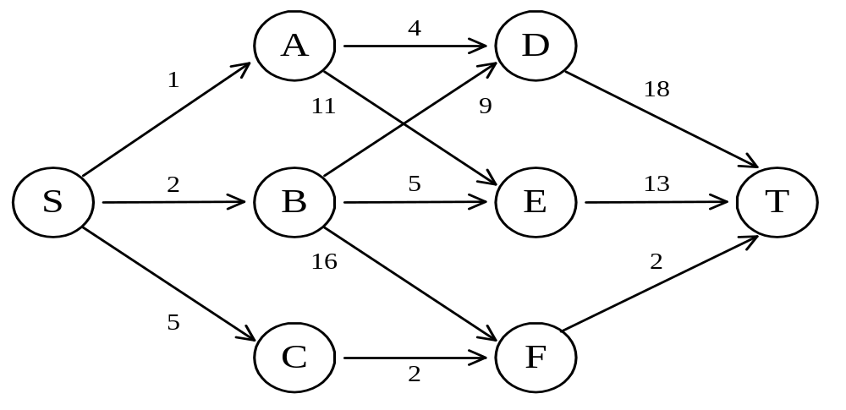
The shortest path in multistage graphs
e.g.
The greedy method can not be applied to this case: (S, A, D, T) 1+4+18 = 23.

Slide 10
The shortest path in multistage graphs
e.g.
The greedy method can not be applied to this case: (S, A, D, T) 1+4+18 = 23.
The real shortest path is:
(S, C, F, T) 5+2+2 = 9.

Slide 11
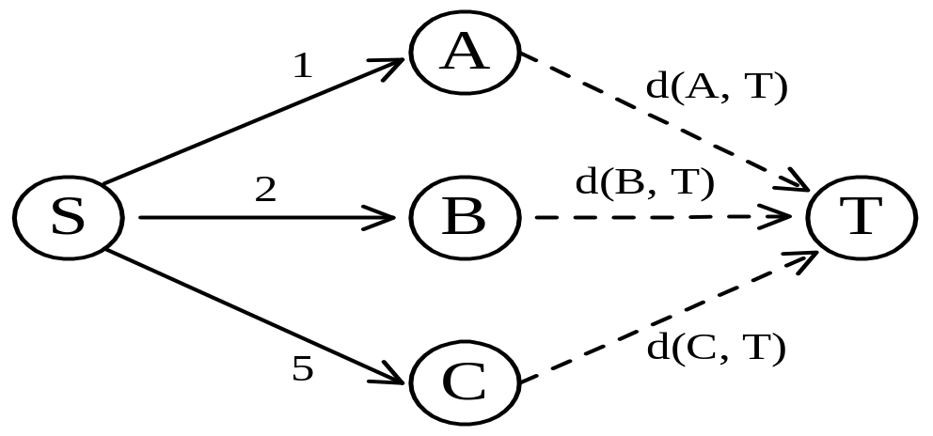
Dynamic programming approach
Dynamic programming approach (forward approach):
d(S, T) = min{1+d(A, T), 2+d(B, T), 5+d(C, T)}

Slide 12
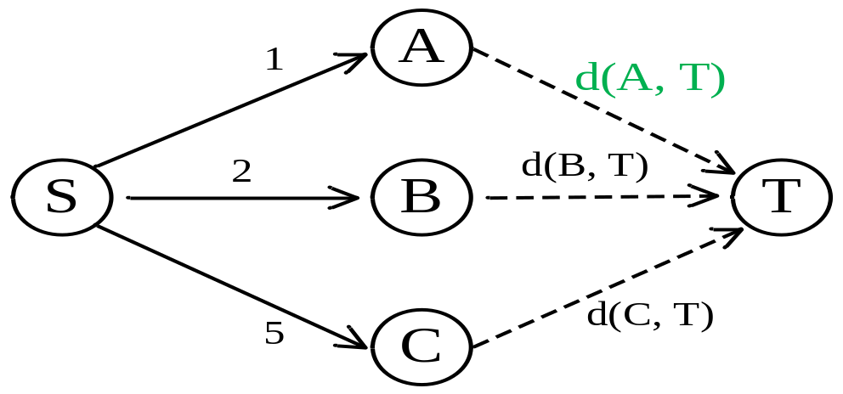
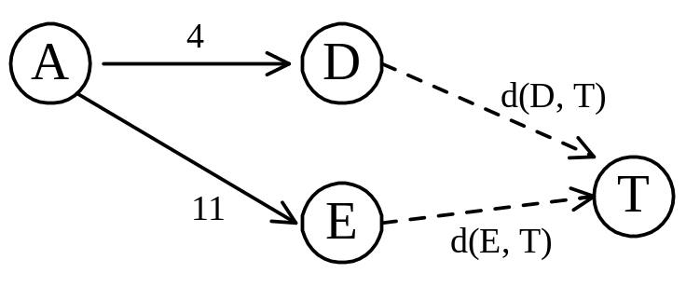
Dynamic programming approach
Dynamic programming approach (forward approach):
d(A,T) = min{4+d(D,T), 11+d(E,T)}
= min{4+18, 11+13} = 22.

Slide 13
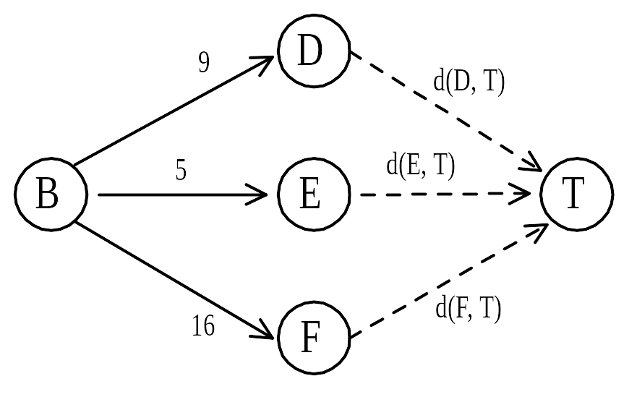
Dynamic programming
d(B, T) = min{9+d(D, T), 5+d(E, T), 16+d(F, T)}
= min{9+18, 5+13, 16+2} = 18.

Slide 14
Dynamic programming
d(C, T) = min{ 2+d(F, T) } = 2+2 = 4

Slide 15
Dynamic programming
d(S, T) = min{1+d(A, T), 2+d(B, T), 5+d(C, T)}
= min{1+22, 2+18, 5+4} = 9.
The above way of reasoning is called backward reasoning.

Slide 16
Psudo Code for Multistage Graph
int[] MStageForward(Graph G)
{
// returns vector of vertices to follow through the graph
// let c[i][j] be the cost matrix of G
int n = G.n (number of nodes);
int k = G.k (number of stages);
float[] C = new float[n];
int[] D = new int[n];
int[] P = new int[k];
for (i = 1 to n) C[i] = 0.0;
for j = n-1 to 1 by -1
{
r = vertex such that (j,r) in G.E and c(j,r)+C(r) is minimum
C[j] = c(j,r)+C(r);
D[j] = r;
}
P[1] = 1;
P[k] = n;
for j = 2 to k-1
{
P[j] = D[P[j-1]];
}
return P;
}

Slide 17
Backward approach
(forward reasoning)
d(S, A) = 1
d(S, B) = 2
d(S, C) = 5

Slide 18
Backward approach
(forward reasoning)
d(S,D)=min{d(S, A)+d(A, D),d(S, B)+d(B, D)}
= min{ 1+4, 2+9 } = 5

Slide 19
Backward approach
(forward reasoning)
d(S,E)=min{d(S, A)+d(A, E),d(S, B)+d(B, E)}
= min{ 1+11, 2+5 } = 7

Slide 20
Backward approach
(forward reasoning)
d(S,F)=min{d(S, B)+d(B, F),d(S, C)+d(C, F)}
= min{ 2+16, 5+2 } = 7

Slide 21
d(S,T) = min{d(S, D)+d(D, T),d(S,E)+
d(E,T), d(S, F)+d(F, T)}
= min{ 5+18, 7+13, 7+2 }
= 9

Slide 22
Principle of optimality
Principle of optimality: Suppose that in solving a problem, we have to make a sequence of decisions D₁, D₂, …, D_{n}. If this sequence is optimal, then the last k decisions, 1 < k < n must be optimal.
e.g. the shortest path problem
If i, i₁, i₂, …, j is a shortest path from i to j, then i₁, i₂, …, j must be a shortest path from i₁ to j.

Slide 23
Dynamic programming
Forward approach and backward approach:
  Note that if the recurrence relations are formulated using the forward approach then the relations are solved backwards . i.e., beginning with the last decision
  On the other hand if the relations are formulated using the backward approach, they are solved forwards.
To solve a problem by using dynamic programming:
  Find out the recurrence relations.
  Represent the problem by a multistage graph.

Slide 24
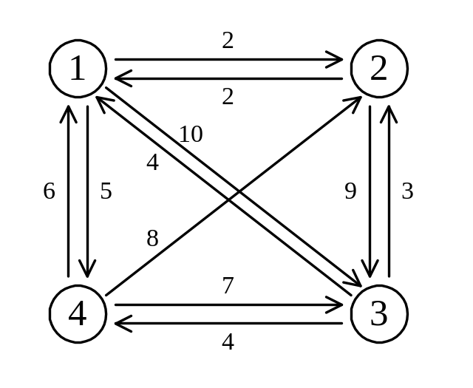
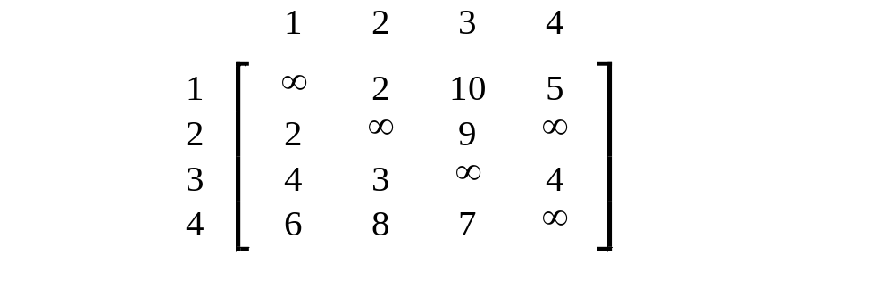
The traveling salesperson (TSP) problem
e.g. a directed graph :
Cost matrix:

Slide 25
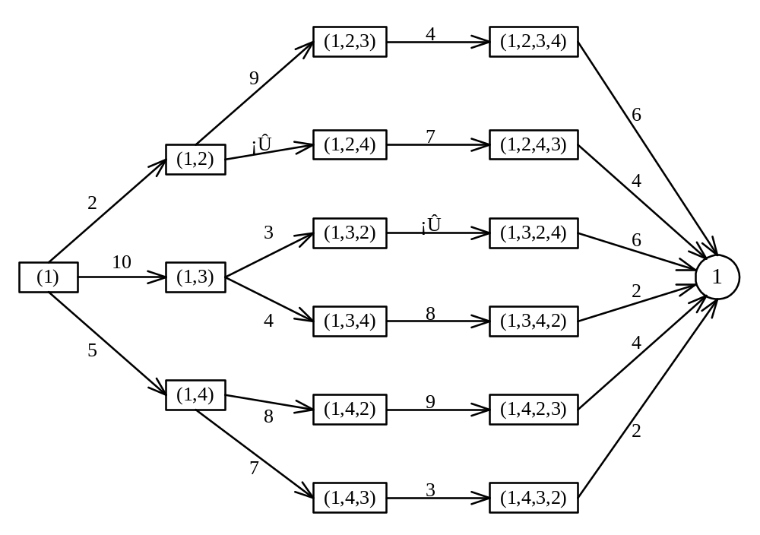
The multistage graph solution
A multistage graph can describe all possible tours of a directed graph.
Find the shortest path:
(1, 4, 3, 2, 1) 5+7+3+2=17

Slide 26
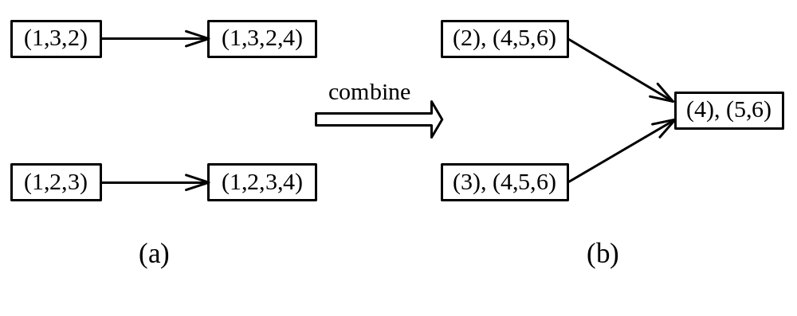
The representation of a node
Suppose that we have 6 vertices in the graph.
We can combine {1, 2, 3, 4} and {1, 3, 2, 4} into one node.
(3),(4,5,6) means that the last vertex visited is 3 and the remaining vertices to be visited are (4, 5, 6).

Slide 27
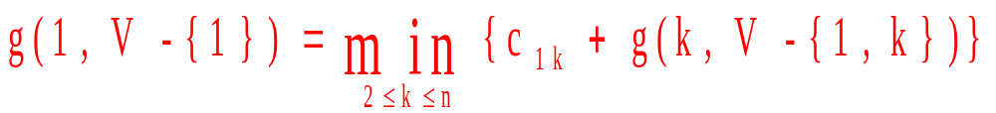
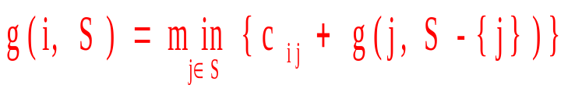
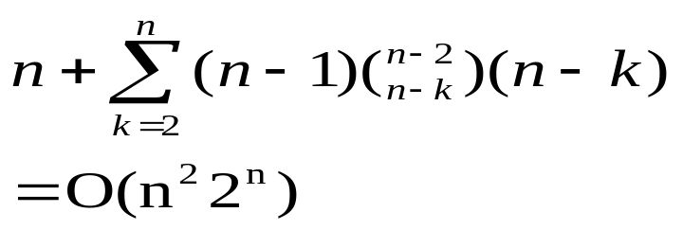

The dynamic programming approach
Let g(i, S) be the length of a shortest path starting at vertex i, going through all vertices in S and terminating at vertex 1.
The length of an optimal tour :
The general form:
Time complexity:
( ),( ) (n-k)
↑ ↑
(n-1)

Slide 28
0-1 Knapsack problem

Slide 29
Knapsack problem
Given some items, pack the knapsack to get
the maximum total value. Each item has some
weight and some value. Total weight that we can
carry is no more than some fixed number W.
So we must consider weights of items as well as
their values.
      Item # Weight Value
      1 1 8
      2 3 6
      3 5 5

Slide 30
Knapsack problem
There are two versions of the problem:
  “0-1 knapsack problem”
    Items are indivisible; you either take an item or not. Some special instances can be solved with dynamic programming
  “Fractional knapsack problem”
    Items are divisible: you can take any fraction of an item

Slide 31
0-1 Knapsack problem
Given a knapsack with maximum capacity W, and a set S consisting of n items
Each item i has some weight w_{i} and benefit value b_{i} (all w_{i} and W are integer values)
Problem: How to pack the knapsack to achieve maximum total value of packed items?

Slide 32
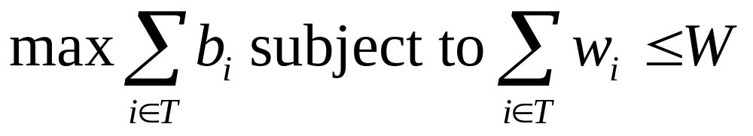
0-1 Knapsack problem
Problem, in other words, is to find
The problem is called a “0-1” problem, because each item must be entirely accepted or rejected.

Slide 33
0-1 Knapsack problem: brute-force approach
Let’s first solve this problem with a straightforward algorithm
Since there are n items, there are 2^{n} possible combinations of items.
We go through all combinations and find the one with maximum value and with total weight less or equal to W
Running time will be O(2^{n})

Slide 34
0-1 Knapsack problem: dynamic programming approach
We can do better with an algorithm based on dynamic programming
We need to carefully identify the subproblems

Slide 35
Defining a Subproblem
We can do better with an algorithm based on dynamic programming
We need to carefully identify the subproblems
Let’s try this:
If items are labeled 1..n, then a subproblem
would be to find an optimal solution for
S_{k} = {items labeled 1, 2, .. k}

Slide 36
Defining a Subproblem
If items are labeled 1..n, then a subproblem would be to find an optimal solution for S_{k} = {items labeled 1, 2, .. k}
This is a reasonable subproblem definition.
The question is: can we describe the final solution (S_{n} ) in terms of subproblems (S_{k})?
Unfortunately, we can’t do that.

Slide 37
Defining a Subproblem
w₁ =2
b₁ =3
w₂ =4
b₂ =5
w₃ =5
b₃ =8
w₄ =3
b₄ =4
Weight
Benefit
Item
#
w_{i}
b_{i}
1
2
3
Max weight: W = 20
For S₄:
Total weight: 14
Maximum benefit: 20
S₄
2
4
5
S₅
3
5
8
4
3
4
5
9
10
w₁ =2
b₁ =3
w₂ =4
b₂ =5
w₃ =5
b₃ =8
w₅ =9
b₅ =10
Solution for S₄ is not part of the solution for S₅!!!
For S₅:
Total weight: 20
Maximum benefit: 26

Slide 38
Defining a Subproblem
As we have seen, the solution for S₄ is not part of the solution for S₅
So our definition of a subproblem is flawed and we need another one!

Slide 39
Defining a Subproblem
Given a knapsack with maximum capacity W, and a set S consisting of n items
Each item i has some weight w_{i} and benefit value b_{i} (all w_{i} and W are integer values)
Problem: How to pack the knapsack to achieve maximum total value of packed items?

Slide 40
Defining a Subproblem
Let’s add another parameter: w, which will represent the maximum weight for each subset of items
The subproblem then will be to compute V[k,w], i.e., to find an optimal solution for S_{k} = {items labeled 1, 2, .. k} in a knapsack of size w

Slide 41
Recursive Formula for subproblems
The subproblem will then be to compute V[k,w], i.e., to find an optimal solution for S_{k} = {items labeled 1, 2, .. k} in a knapsack of size w
Assuming knowing V[i, j], where i=0,1, 2, … k-1, j=0,1,2, …w, how to derive V[k,w]?

Slide 42
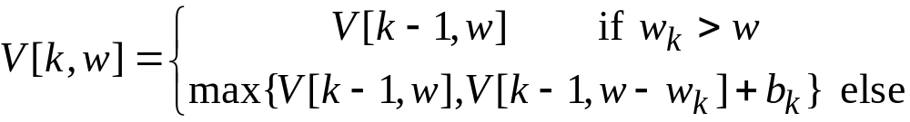
Recursive Formula for subproblems (continued)
Recursive formula for subproblems:
It means, that the best subset of S_{k} that has total weight w is:
  1) the best subset of S_{k-1} that has total weight ≤ w, or
  2) the best subset of S_{k-1} that has total weight ≤ w-w_{k} plus the item k

Slide 43
Recursive Formula
The best subset of S_{k} that has the total weight ≤ w, either contains item k or not.
First case: w_{k}>w. Item k can’t be part of the solution, since if it was, the total weight would be > w, which is unacceptable.
Second case: w_{k} ≤ w. Then the item k can be in the solution, and we choose the case with greater value.

Slide 44
0-1 Knapsack Algorithm
for w = 0 to W
V[0,w] = 0
for i = 1 to n
V[i,0] = 0
for i = 1 to n
for w = 0 to W
if w_{i} <= w // item i can be part of the solution
if b_{i} + V[i-1,w-w_{i}] > V[i-1,w]
V[i,w] = b_{i} + V[i-1,w- w_{i}]
else
V[i,w] = V[i-1,w]
else V[i,w] = V[i-1,w] // w_{i} > w

Slide 45
Running time
for w = 0 to W
V[0,w] = 0
for i = 1 to n
V[i,0] = 0
for i = 1 to n
for w = 0 to W
< the rest of the code >
O(W)
Repeat n times
O(W)
What is the running time of this algorithm?
O(n*W)
Remember that the brute-force algorithm
takes O(2^{n})

Slide 46
Example
Let’s run our algorithm on the
following data:
n = 4 (# of elements)
W = 5 (max weight)
Elements (weight, benefit):
(2,3), (3,4), (4,5), (5,6)

Slide 47
Example (2)
i\W
0
1
2
3
4
5
0
0
0
0
0
0
0
1
2
3
4
for w = 0 to W
V[0,w] = 0

Slide 48
Example (3)
i\W
0
1
2
3
4
5
0
0
0
0
0
0
0
1
0
2
0
3
0
4
0
for i = 1 to n
V[i,0] = 0

Slide 49
Example (4)
Items:
1: (2,3)
2: (3,4)
3: (4,5)
4: (5,6)
i\W
0
1
2
3
4
5
i=1
b_{i}=3
w_{i}=2
w=1
w-w_{i} =-1
0
0
0
0
0
0
0
1
0
0
2
0
3
0
4
0
if w_{i} <= w // item i can be part of the solution
if b_{i} + V[i-1,w-w_{i}] > V[i-1,w]
V[i,w] = b_{i} + V[i-1,w- w_{i}]
else
V[i,w] = V[i-1,w]
else V[i,w] = V[i-1,w] // w_{i} > w

Slide 50
Example (5)
Items:
1: (2,3)
2: (3,4)
3: (4,5)
4: (5,6)
i\W
0
1
2
3
4
5
i=1
b_{i}=3
w_{i}=2
w=2
w-w_{i} =0
0
0
0
0
0
0
0
1
0
0
3
2
0
3
0
4
0
if w_{i} <= w // item i can be part of the solution
if b_{i} + V[i-1,w-w_{i}] > V[i-1,w]
V[i,w] = b_{i} + V[i-1,w- w_{i}]
else
V[i,w] = V[i-1,w]
else V[i,w] = V[i-1,w] // w_{i} > w

Slide 51
Example (6)
Items:
1: (2,3)
2: (3,4)
3: (4,5)
4: (5,6)
i\W
0
1
2
3
4
5
i=1
b_{i}=3
w_{i}=2
w=3
w-w_{i} =1
0
0
0
0
0
0
0
1
0
0
3
3
2
0
3
0
4
0
if w_{i} <= w // item i can be part of the solution
if b_{i} + V[i-1,w-w_{i}] > V[i-1,w]
V[i,w] = b_{i} + V[i-1,w- w_{i}]
else
V[i,w] = V[i-1,w]
else V[i,w] = V[i-1,w] // w_{i} > w

Slide 52
Example (7)
Items:
1: (2,3)
2: (3,4)
3: (4,5)
4: (5,6)
i\W
0
1
2
3
4
5
i=1
b_{i}=3
w_{i}=2
w=4
w-w_{i} =2
0
0
0
0
0
0
0
1
0
0
3
3
3
2
0
3
0
4
0
if w_{i} <= w // item i can be part of the solution
if b_{i} + V[i-1,w-w_{i}] > V[i-1,w]
V[i,w] = b_{i} + V[i-1,w- w_{i}]
else
V[i,w] = V[i-1,w]
else V[i,w] = V[i-1,w] // w_{i} > w

Slide 53
Example (8)
Items:
1: (2,3)
2: (3,4)
3: (4,5)
4: (5,6)
i\W
0
1
2
3
4
5
i=1
b_{i}=3
w_{i}=2
w=5
w-w_{i} =3
0
0
0
0
0
0
0
1
0
0
3
3
3
3
2
0
3
0
4
0
if w_{i} <= w // item i can be part of the solution
if b_{i} + V[i-1,w-w_{i}] > V[i-1,w]
V[i,w] = b_{i} + V[i-1,w- w_{i}]
else
V[i,w] = V[i-1,w]
else V[i,w] = V[i-1,w] // w_{i} > w

Slide 54
Example (9)
Items:
1: (2,3)
2: (3,4)
3: (4,5)
4: (5,6)
i\W
0
1
2
3
4
5
i=2
b_{i}=4
w_{i}=3
w=1
w-w_{i} =-2
0
0
0
0
0
0
0
1
0
0
3
3
3
3
2
0
0
3
0
4
0
if w_{i} <= w // item i can be part of the solution
if b_{i} + V[i-1,w-w_{i}] > V[i-1,w]
V[i,w] = b_{i} + V[i-1,w- w_{i}]
else
V[i,w] = V[i-1,w]
else V[i,w] = V[i-1,w] // w_{i} > w

Slide 55
Example (10)
Items:
1: (2,3)
2: (3,4)
3: (4,5)
4: (5,6)
i\W
0
1
2
3
4
5
i=2
b_{i}=4
w_{i}=3
w=2
w-w_{i} =-1
0
0
0
0
0
0
0
1
0
0
3
3
3
3
2
0
0
3
3
0
4
0
if w_{i} <= w // item i can be part of the solution
if b_{i} + V[i-1,w-w_{i}] > V[i-1,w]
V[i,w] = b_{i} + V[i-1,w- w_{i}]
else
V[i,w] = V[i-1,w]
else V[i,w] = V[i-1,w] // w_{i} > w

Slide 56
Example (11)
Items:
1: (2,3)
2: (3,4)
3: (4,5)
4: (5,6)
i\W
0
1
2
3
4
5
i=2
b_{i}=4
w_{i}=3
w=3
w-w_{i} =0
0
0
0
0
0
0
0
1
0
0
3
3
3
3
2
0
0
3
4
3
0
4
0
if w_{i} <= w // item i can be part of the solution
if b_{i} + V[i-1,w-w_{i}] > V[i-1,w]
V[i,w] = b_{i} + V[i-1,w- w_{i}]
else
V[i,w] = V[i-1,w]
else V[i,w] = V[i-1,w] // w_{i} > w

Slide 57
Example (12)
Items:
1: (2,3)
2: (3,4)
3: (4,5)
4: (5,6)
i\W
0
1
2
3
4
5
i=2
b_{i}=4
w_{i}=3
w=4
w-w_{i} =1
0
0
0
0
0
0
0
1
0
0
3
3
3
3
2
0
0
3
4
4
3
0
4
0
if w_{i} <= w // item i can be part of the solution
if b_{i} + V[i-1,w-w_{i}] > V[i-1,w]
V[i,w] = b_{i} + V[i-1,w- w_{i}]
else
V[i,w] = V[i-1,w]
else V[i,w] = V[i-1,w] // w_{i} > w

Slide 58
Example (13)
Items:
1: (2,3)
2: (3,4)
3: (4,5)
4: (5,6)
i\W
0
1
2
3
4
5
i=2
b_{i}=4
w_{i}=3
w=5
w-w_{i} =2
0
0
0
0
0
0
0
1
0
0
3
3
3
3
2
0
0
3
4
4
7
3
0
4
0
if w_{i} <= w // item i can be part of the solution
if b_{i} + V[i-1,w-w_{i}] > V[i-1,w]
V[i,w] = b_{i} + V[i-1,w- w_{i}]
else
V[i,w] = V[i-1,w]
else V[i,w] = V[i-1,w] // w_{i} > w

Slide 59
Example (14)
Items:
1: (2,3)
2: (3,4)
3: (4,5)
4: (5,6)
i\W
0
1
2
3
4
5
i=3
b_{i}=5
w_{i}=4
w= 1..3
0
0
0
0
0
0
0
1
0
0
3
3
3
3
2
0
0
3
4
4
7
3
0
0
3
4
4
0
if w_{i} <= w // item i can be part of the solution
if b_{i} + V[i-1,w-w_{i}] > V[i-1,w]
V[i,w] = b_{i} + V[i-1,w- w_{i}]
else
V[i,w] = V[i-1,w]
else V[i,w] = V[i-1,w] // w_{i} > w

Slide 60
Example (15)
Items:
1: (2,3)
2: (3,4)
3: (4,5)
4: (5,6)
i\W
0
1
2
3
4
5
i=3
b_{i}=5
w_{i}=4
w= 4
w- w_{i}=0
0
0
0
0
0
0
0
1
0
0
3
3
3
3
2
0
0
3
4
4
7
3
0
0
3
4
5
4
0
if w_{i} <= w // item i can be part of the solution
if b_{i} + V[i-1,w-w_{i}] > V[i-1,w]
V[i,w] = b_{i} + V[i-1,w- w_{i}]
else
V[i,w] = V[i-1,w]
else V[i,w] = V[i-1,w] // w_{i} > w

Slide 61
Example (16)
Items:
1: (2,3)
2: (3,4)
3: (4,5)
4: (5,6)
i\W
0
1
2
3
4
5
i=3
b_{i}=5
w_{i}=4
w= 5
w- w_{i}=1
0
0
0
0
0
0
0
1
0
0
3
3
3
3
2
0
0
3
4
4
7
3
0
0
3
4
5
7
4
0
if w_{i} <= w // item i can be part of the solution
if b_{i} + V[i-1,w-w_{i}] > V[i-1,w]
V[i,w] = b_{i} + V[i-1,w- w_{i}]
else
V[i,w] = V[i-1,w]
else V[i,w] = V[i-1,w] // w_{i} > w

Slide 62
Example (17)
Items:
1: (2,3)
2: (3,4)
3: (4,5)
4: (5,6)
i\W
0
1
2
3
4
5
i=4
b_{i}=6
w_{i}=5
w= 1..4
0
0
0
0
0
0
0
1
0
0
3
3
3
3
2
0
0
3
4
4
7
3
0
0
3
4
5
7
4
0
0
3
4
5
if w_{i} <= w // item i can be part of the solution
if b_{i} + V[i-1,w-w_{i}] > V[i-1,w]
V[i,w] = b_{i} + V[i-1,w- w_{i}]
else
V[i,w] = V[i-1,w]
else V[i,w] = V[i-1,w] // w_{i} > w

Slide 63
Example (18)
Items:
1: (2,3)
2: (3,4)
3: (4,5)
4: (5,6)
i\W
0
1
2
3
4
5
i=4
b_{i}=6
w_{i}=5
w= 5
w- w_{i}=0
0
0
0
0
0
0
0
1
0
0
3
3
3
3
2
0
0
3
4
4
7
3
0
0
3
4
5
7
4
0
0
3
4
5
7
if w_{i} <= w // item i can be part of the solution
if b_{i} + V[i-1,w-w_{i}] > V[i-1,w]
V[i,w] = b_{i} + V[i-1,w- w_{i}]
else
V[i,w] = V[i-1,w]
else V[i,w] = V[i-1,w] // w_{i} > w

Slide 64
Comments
This algorithm only finds the max possible value that can be carried in the knapsack
  i.e., the value in V[n,W]
To know the items that make this maximum value, an addition to this algorithm is necessary

Slide 65
How to find actual Knapsack Items
All of the information we need is in the table.
V[n,W] is the maximal value of items that can be placed in the Knapsack.
Let i=n and k=W
  if V[i,k] ≠ V[i−1,k] then
  mark the i^{th} item as in the knapsack
  i = i−1, k = k-w_{i}
  else
  i = i−1 // Assume the i^{th} item is not in the knapsack
  // Could it be in the optimally packed knapsack?

Slide 66
Finding the Items
Items:
1: (2,3)
2: (3,4)
3: (4,5)
4: (5,6)
i\W
0
1
2
3
4
5
i=4
k= 5
b_{i}=6
w_{i}=5
V[i,k] = 7
V[i−1,k] =7
0
0
0
0
0
0
0
1
0
0
3
3
3
3
2
0
0
3
4
4
7
3
0
0
3
4
5
7
4
0
0
3
4
5
7
i=n, k=W
while i,k > 0
  if V[i,k] ≠ V[i−1,k] then
  mark the i^{th} item as in the knapsack
  i = i−1, k = k-w_{i}
  else
  i = i−1

Slide 67
Finding the Items (2)
Items:
1: (2,3)
2: (3,4)
3: (4,5)
4: (5,6)
i\W
0
1
2
3
4
5
i=4
k= 5
b_{i}=6
w_{i}=5
V[i,k] = 7
V[i−1,k] =7
0
0
0
0
0
0
0
1
0
0
3
3
3
3
2
0
0
3
4
4
7
3
0
0
3
4
5
7
4
0
0
3
4
5
7
i=n, k=W
while i,k > 0
  if V[i,k] ≠ V[i−1,k] then
  mark the i^{th} item as in the knapsack
  i = i−1, k = k-w_{i}
  else
  i = i−1

Slide 68
Finding the Items (3)
Items:
1: (2,3)
2: (3,4)
3: (4,5)
4: (5,6)
i\W
0
1
2
3
4
5
i=3
k= 5
b_{i}=5
w_{i}=4
V[i,k] = 7
V[i−1,k] =7
0
0
0
0
0
0
0
1
0
0
3
3
3
3
2
0
0
3
4
4
7
3
0
0
3
4
5
7
4
0
0
3
4
5
7
i=n, k=W
while i,k > 0
  if V[i,k] ≠ V[i−1,k] then
  mark the i^{th} item as in the knapsack
  i = i−1, k = k-w_{i}
  else
  i = i−1

Slide 69
Finding the Items (4)
Items:
1: (2,3)
2: (3,4)
3: (4,5)
4: (5,6)
i\W
0
1
2
3
4
5
i=2
k= 5
b_{i}=4
w_{i}=3
V[i,k] = 7
V[i−1,k] =3
k − w_{i}=2
0
0
0
0
0
0
0
1
0
0
3
3
3
3
2
0
0
3
4
4
7
7
3
0
0
3
4
5
7
4
0
0
3
4
5
7
i=n, k=W
while i,k > 0
  if V[i,k] ≠ V[i−1,k] then
  mark the i^{th} item as in the knapsack
  i = i−1, k = k-w_{i}
  else
  i = i−1

Slide 70
Finding the Items (5)
Items:
1: (2,3)
2: (3,4)
3: (4,5)
4: (5,6)
i\W
0
1
2
3
4
5
i=1
k= 2
b_{i}=3
w_{i}=2
V[i,k] = 3
V[i−1,k] =0
k − w_{i}=0
0
0
0
0
0
0
0
1
0
0
3
3
3
3
3
2
0
0
3
4
4
7
3
0
0
3
4
5
7
4
0
0
3
4
5
7
i=n, k=W
while i,k > 0
  if V[i,k] ≠ V[i−1,k] then
  mark the i^{th} item as in the knapsack
  i = i−1, k = k-w_{i}
  else
  i = i−1

Slide 71
Finding the Items (6)
Items:
1: (2,3)
2: (3,4)
3: (4,5)
4: (5,6)
i\W
0
1
2
3
4
5
i=0
k= 0
0
0
0
0
0
0
0
1
0
0
3
3
3
3
2
0
0
3
4
4
7
3
0
0
3
4
5
7
The optimal knapsack should contain {1, 2}
4
0
0
3
4
5
7
i=n, k=W
while i,k > 0
  if V[i,k] ≠ V[i−1,k] then
  mark the n^{th} item as in the knapsack
  i = i−1, k = k-w_{i}
  else
  i = i−1

Slide 72
Finding the Items (7)
Items:
1: (2,3)
2: (3,4)
3: (4,5)
4: (5,6)
i\W
0
1
2
3
4
5
0
0
0
0
0
0
0
1
0
0
3
3
3
3
3
2
0
0
3
4
4
7
7
3
0
0
3
4
5
7
The optimal knapsack should contain {1, 2}
4
0
0
3
4
5
7
i=n, k=W
while i,k > 0
  if V[i,k] ≠ V[i−1,k] then
  mark the n^{th} item as in the knapsack
  i = i−1, k = k-w_{i}
  else
  i = i−1

Slide 73
0-1 Knapsack Memory Function Algorithm
for i = 1 to n
for w = 1 to W
V[i,w] = -1
for w = 0 to W
V[0,w] = 0
for i = 1 to n
V[i,0] = 0
MFKnapsack(i, w)
if V[i,w] < 0
if w < w_{i}
value = MFKnapsack(i-1, w)
else
value = max(MFKnapsack(i-1, w),
b_{i} + MFKnapsack(i-1, w-w_{i}))
V[i,w] = value
return V[i,w]

Slide 74
Conclusion
Dynamic programming is a useful technique of solving certain kind of problems
When the solution can be recursively described in terms of partial solutions, we can store these partial solutions and re-use them as necessary (memorization)
Running time of dynamic programming algorithm vs. naïve algorithm:
  0-1 Knapsack problem: O(W*n) vs. O(2^{n})

Slide 75
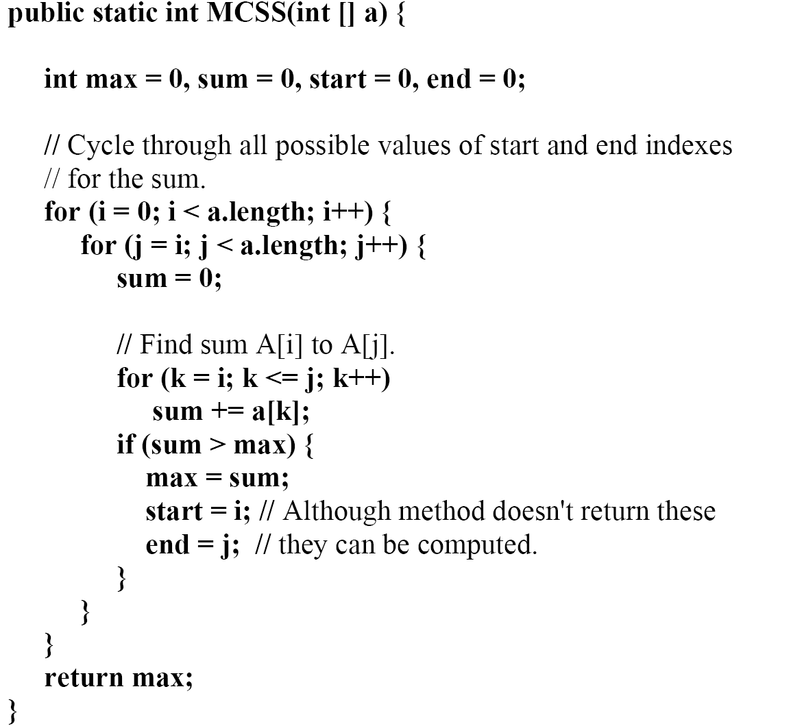
Brute-Force Approach
Design and Analysis of Algorithms - Chapter 8

Slide 76
Problem
Assume that we have a knapsack with max weight capacity W = 5
Our objective is to fill the knapsack with items such that the benefit (value or profit) is maximum.
Following table contains the items along with their value and weight.
Total items n = 4
Total capacity of the knapsack W = 5
item i | 1 | 2 | 3 | 4
value val | 100 | 20 | 60 | 40
weight wt | 3 | 2 | 4 | 1

Slide 77
Solution
After calculation, the value table V
Maximum value earned
Max Value = V[n,W]
= V[4,5]
= 140
V[i,w] | w = 0 | 1 | 2 | 3 | 4 | 5
i = 0 | 0 | 0 | 0 | 0 | 0 | 0
1 | 0 | 0 | 0 | 100 | 100 | 100
2 | 0 | 0 | 20 | 100 | 100 | 120
3 | 0 | 0 | 20 | 100 | 100 | 120
4 | 0 | 40 | 40 | 100 | 140 | 140

Slide 78
Solution
After calculation, the value table V
Maximum value earned
Max Value = V[n,W]
= V[4,5]
= 140
V[i,w] | w = 0 | 1 | 2 | 3 | 4 | 5
i = 0 | 0 | 0 | 0 | 0 | 0 | 0
1 | 0 | 0 | 0 | 100 | 100 | 100
2 | 0 | 0 | 20 | 100 | 100 | 120
3 | 0 | 0 | 20 | 100 | 100 | 120
4 | 0 | 40 | 40 | 100 | 140 | 140
Items we are putting inside the knapsack are 4 and 1

